Slide 1

Spring
2
Pronouns &
Negative Numbers
Stuy Prep
Lesson 26S2
Notes:
Slide designed by Benjamin Xie. Logo designed by Madeleine Villamil.

Slide 2
Welcome
Questions on Homework 1?
If not, here’s an icebreaker:
Punctuation and Operations
Would you rather always walk like a penguin, or always walk like a pigeon?
₊✩‧₊˚౨ৎ˚₊✩‧₊ ✮ ⋆ ˚｡⋆｡°✩⋆˚˖°
Notes:
Slide designed by Benjamin Xie. Logo designed by Madeleine Villamil.

Slide 3
he she his mine theirs you they us yourself
Spring
2
English Language Arts
Pronouns
Aim: Recognize and understand pronouns and when to use them correctly.
Do Now: What are your pronouns?
he she we her mine yours it they his
Notes:
Slide designed by Amy Shrestha.

Slide 4
Pronouns
A pronoun is a word that takes the place of a noun.
Example
Instead of calling someone by their name, you call them by “her” or “him.”
Karen lost her phone, and Maria noticed, asking, “Did you lose your phone?”
he she we her mine yours it they his
Notes:
Slide designed by Amy Shrestha.

Slide 5
Pronouns
Use pronouns to . . .
Example (before)
Avoid repetition!
Maria forgot Maria’s backpack, so Maria went back for Maria’s backpack.
he she we her mine yours it they his
Notes:
Slide designed by Amy Shrestha.

Slide 6
Pronouns
Use pronouns to . . .
Example (after)
Avoid repetition!
Maria forgot her backpack, so she went back for it.
he she we her mine yours it they his
Notes:
Slide designed by Amy Shrestha.

Slide 7
Antecedents
The antecedent is the noun replaced by the pronoun.
Example
You refer to someone by their name directly instead of “her” or “him.”
Karen lost her phone, and Maria noticed, asking, “Did you lose your phone?”
he she we her mine yours it they his
Notes:
Slide designed by Amy Shrestha.

Slide 8
Antecedents
The antecedent is the noun replaced by the pronoun.
Example
The antecedent usually comes before the pronoun, in the same sentence or a previous sentence.
Maria forgot her backpack, so she went back for it.
he she we her mine yours it they his
Notes:
Slide designed by Amy Shrestha.

Slide 9
Personal Pronouns
Subject Pronouns
Example
Used when the pronoun is the subject of the sentence.
I, you, he, she, it, we, they
They are late; it’s been nearly 20 minutes since the arranged time!
he she we her mine yours it they his
Notes:
Slide designed by Amy Shrestha.

Slide 10
Personal Pronouns
Object Pronouns
Example
Used when the pronoun is the object of the sentence.
me, you, him, her, it, us, them
Give the chocolate bar you’ve been hiding to me.
he she we her mine yours it they his
Notes:
Slide designed by Amy Shrestha.

Slide 11
Possessive Pronouns
Use pronouns to . . .
Example
Show ownership or possession.
That book on the teacher’s desk with the blue cover is hers, not mine.
he she we her mine yours it they his
Notes:
Slide designed by Amy Shrestha.

Slide 12
Relative Pronouns
Use pronouns to . . .
Example
Combine clauses (independent and dependent clauses).
The student who won the science fair smiled proudly as she walked up to receive her award.
he she we her mine yours it they his
Notes:
Slide designed by Amy Shrestha.

Slide 13
Interrogative Pronouns
Use pronouns to . . .
Example
Ask questions (not the 5 W’s, but: who, whom, whose, which, what).
Which of these two desserts do you want for your birthday party tonight?
he she we her mine yours it they his
Notes:
Slide designed by Amy Shrestha.

Slide 14
Common Pronoun Errors
Missing Antecedent
Example (before)
Pronouns must have an antecedent.
In the newspaper, it says that the governor will resign.
he she we her mine yours it they his
Notes:
Slide designed by Amy Shrestha.

Slide 15
Common Pronoun Errors
Missing Antecedent
Example (after)
In this sentence, there is no antecedent, because we don’t know what the word “it” is taking the place of in this sentence.
In the newspaper, the board says that the governor will resign.
he she we her mine yours it they his
Notes:
Slide designed by Amy Shrestha.

Slide 16
Common Pronoun Errors
Antecedent Disagreement
Example (before)
Correctly used pronouns must agree in number and in person with the antecedent.
Someone left their coat on the chair.
he she we her mine yours it they his
Notes:
Slide designed by Amy Shrestha.

Slide 17
Common Pronoun Errors
Antecedent Disagreement
Example (after)
The singular antecedent “someone” disagrees with the plural pronoun “their.” The correct pronoun is “his” or “her.”
Someone left his or her coat on the chair.
he she we her mine yours it they his
Notes:
Slide designed by Amy Shrestha.

Slide 18
Common Pronoun Errors
Ambiguous Pronoun
Example (before)
A sentence may use an antecedent like “his” or “her,” and it’s unclear which specific person is being mentioned.
John and Bob took his car to the store.
he she we her mine yours it they his
Notes:
Slide designed by Amy Shrestha.

Slide 19
Common Pronoun Errors
Ambiguous Pronoun
Example (after)
The pronoun “his” has two possible singular antecedents: John or Bob. To correct the sentence, the pronoun has to be replaced with a possessive noun.
While walking to the bus stop, Gina was drenched by the rain.
he she we her mine yours it they his
Notes:
Slide designed by Amy Shrestha.

Slide 20
Modifiers
Modifiers are…
INCORRECT Example
a word or phrase that describes, clarifies, or provides additional information about another part of the sentence
John and Bob took John’s car to the store.
John and Bob took Bob’s car to the store.
he she we her mine yours it they his
Notes:
Slide designed by Amy Shrestha.

Slide 21
Modifiers
Modifiers are…
CORRECT Example
placed closest to the word they are describing as possible. In this case, Gina was walking to the bus stop, not the rain.
While walking to the bus stop, Gina was drenched by the rain.
he she we her mine yours it they his
Notes:
Slide designed by Amy Shrestha.

Slide 22
Practice
Correct the pronoun error(s) in the following sentences:
1. If a student parks a car on campus, they have to buy a parking sticker.
2. Everybody ought to do our best.
3. Neither of the girls brought their umbrella.
he she we her mine yours it they his
Notes:
Slide designed by Amy Shrestha.

Slide 23
Practice
Correct the pronoun error(s) in the following sentences:
1. If a student parks a car on campus, he or she have to buy a parking sticker.
Since “a student” is singular, so use the singular pronoun “he or she” instead of the plural pronoun “they.”
he she we her mine yours it they his
Notes:
Slide designed by Amy Shrestha.

Slide 24
Practice
Correct the pronoun error(s) in the following sentences:
2. Everybody ought to do their best.
Although “Everybody” looks singular, it is actually plural since it means “each person.” Therefore, we use the plural pronoun “their.”
he she we her mine yours it they his
Notes:
Slide designed by Amy Shrestha.

Slide 25
Practice
Correct the pronoun error(s) in the following sentences:
3. Neither of the girls brought her umbrella.
“Neither” means “not one,” so it’s singular. Since we know it’s referring to not one of the girls, we can use the singular pronoun “she.”
he she we her mine yours it they his
Notes:
Also acceptable: Neither of the girls brought an umbrella.
Slide designed by Amy Shrestha.

Slide 26
-13 |2 - 25| -53 -1 -240 |-50| -94
Spring
2
Mathematics
Negative Numbers
Aim: Understand negative numbers and how they exist on the number line.
Do Now: What are opposite numbers?
-13 |2 - 25| -6122 -1 -240 |-50| -94
Notes:
Slide designed by Amy Shrestha.

Slide 27
Negative Numbers
Negative numbers, or opposite numbers, are numbers with the same value but different signs. Every positive number has its negative counterpart, except 0.
The negative, or opposite, of 4 is -4. The opposite of -12 is 12.
-13 |2 - 25| -6122 -1 -240 |-50| -94
Notes:
Slide designed by Amy Shrestha.

Slide 28
Operations
Adding Negative Numbers
If they have opposite signs, you subtract them and keep the sign of the larger number (number with larger value).
-7 + 5 = 5-7 = -2
If they have the same sign, you add them and keep the negative sign.
-3 + (-4) = -7
-13 |2 - 25| -6122 -1 -240 |-50| -94
Notes:
Slide designed by Amy Shrestha.

Slide 29
Operations
Subtracting Negative Numbers
When subtracting negative numbers, you turn the negative number being subtracted into a positive number and switch the minus sign to a plus.
-5 - (-10) = -5 + 10 = 5
Remember: Keep-Change-Change!
-13 |2 - 25| -6122 -1 -240 |-50| -94
Notes:
Slide designed by Amy Shrestha.

Slide 30
Operations
Multiplying/Dividing Negative Numbers
If the two values being multiplied or divided are the same sign (both negative), the result is positive.
(-3)(-6) = 18
-15/-5 = 3
-13 |2 - 25| -6122 -1 -240 |-50| -94
Notes:
Slide designed by Amy Shrestha.

Slide 31
Operations
Multiplying/Dividing Negative Numbers
If the two values being multiplied or divided are opposite signs (one positive and one negative), the result is negative.
(-3)(2) = -6 or (3)(-2) = -6
-18/6 = -3 or 18/-6 = -3
-13 |2 - 25| -6122 -1 -240 |-50| -94
Notes:
Slide designed by Amy Shrestha.

Slide 32
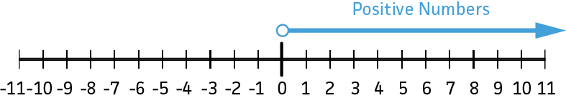
Number Lines
A number line is a horizontal line numbered at regular intervals, from smallest on the left to biggest on the right.
-13 |2 - 25| -6122 -1 -240 |-50| -94
Notes:
Slide designed by Amy Shrestha.

Slide 33
Number Lines
Most number lines place 0 in the middle, but not all of them do. Depending on the problem, the number line could include only positive numbers, only negative numbers, or both.
-13 |2 - 25| -6122 -1 -240 |-50| -94
Notes:
Slide designed by Amy Shrestha.

Slide 34
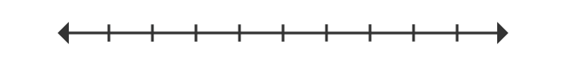
Number Lines
While some number lines use integers for the markers, others also represent fractions and decimals. When placing them on a number line, they are placed in between the numbers they fall into.
-2
-3/2
0
0.5
1
2
-13 |2 - 25| -6122 -1 -240 |-50| -94
Notes:
Slide designed by Amy Shrestha.

Slide 35
Absolute Value
The absolute value of a number is the magnitude of that number. In other words, the distance of that number from zero (on the number line).
For example, the number 5 is 5 units away from the number line, so the absolute value of 5 is 5. The absolute value of -5 is also 5.
-13 |2 - 25| -6122 -1 -240 |-50| -94
Notes:
Slide designed by Amy Shrestha.

Slide 36
Absolute Value
An easy way to think about the absolute value is to change whatever the number is to a positive number.
The absolute value is represented using two | lines.
|8| = 8
|-10| = 10
|-489| = ?
-13 |2 - 25| -6122 -1 -240 |-50| -94
Notes:
489
Slide designed by Amy Shrestha.

Slide 37
Absolute Value
When solving equations that use the absolute value symbol, always solve the inside of the absolute value to its most simplified form.
Tip: Make sure you don't confuse your 1’s with |!
|39-40| = |-1| = 1
|72-13| = ?
-13 |2 - 25| -6122 -1 -240 |-50| -94
Notes:
59
Slide designed by Amy Shrestha.

Slide 38
Absolute Value
When the negative sign is outside the absolute value sign, the negative sign stays.
-|52| = -(52) = -52
-|-4| = -(4) = -4
-|25-26| = ?
-13 |2 - 25| -6122 -1 -240 |-50| -94
Notes:
-1
Slide designed by Amy Shrestha.

Slide 39
Graphing Points
The coordinate plane is formed by two number lines, one vertical (the y-axis) and one horizontal (the x-axis). The two number lines meet at the origin, or (0, 0).
A point on the coordinate plane is defined by (x, y), where x represents how far left/right the point is, and y how far up/down the point is.
-13 |2 - 25| -6122 -1 -240 |-50| -94
Notes:
Slide designed by Amy Shrestha.

Slide 40
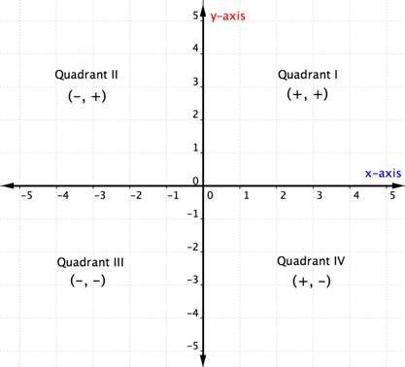
Graphing Points
By having two number lines cut into each other, we create four separate spaces, known as quadrants. There are four quadrants, each with different combinations of signs of the x and y coordinates.
-13 |2 - 25| -6122 -1 -240 |-50| -94
Notes:
Slide designed by Amy Shrestha.

Slide 41
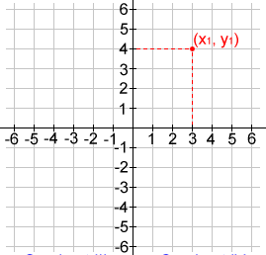
Graphing Points
To graph a point (x, y):
Start at (0, 0)
Move x units left/right
Move y units up/down
Plot the point.
If x (y) is positive, move right (up).
If x (y) is negative, move left (down).
-13 |2 - 25| -6122 -1 -240 |-50| -94
Notes:
Slide designed by Amy Shrestha.

Slide 42
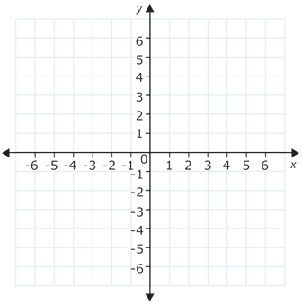
Graphing Points
Graph the point (-3, 4).
Start from (0, 0).
Move 3 units to the left (because -3 is negative).
Move 4 units to the up.
Plot the point.
-13 |2 - 25| -6122 -1 -240 |-50| -94
Notes:
Slide designed by Amy Shrestha.

Slide 43
Practice
For what value of h is the value of (h-2)(h+3)(h-4) negative?
A. -3 B. -2 C. 1 D. 3 E. 4
In order for the value of the expression to be negative, either all three of (h-2), (h+3), and (h-4) have to be negative, or only one of those values is negative.
-13 |2 - 25| -6122 -1 -240 |-50| -94
Notes:
Slide designed by Amy Shrestha.

Slide 44
Practice
What is the value of 4|x| - 7|y| if x=-5 and y=-12?
What is the value of |x-y| + |y+x| if x=-2 and y=-4?
-13 |2 - 25| -6122 -1 -240 |-50| -94
Notes:
Slide designed by Amy Shrestha.

Slide 45
Practice
What is the value of 4|x| - 7|y| if x=-5 and y=-12?
4|x| - 7|y| = 4|-5| - 7|-12|
= 4(5) - 7(12)
= 20 - 84
= -64
-13 |2 - 25| -6122 -1 -240 |-50| -94
Notes:
Slide designed by Amy Shrestha.

Slide 46
Practice
What is the value of |x-y| + |y+x| if x=-2 and y=-4?
|x-y| + |y+x| = |-2-(-4)| - |-4+(-2)|
= |-2+4| - |-4-2|
= |2| - |-6|
= 2 - 6
= -4
-13 |2 - 25| -6122 -1 -240 |-50| -94
Notes:
Slide designed by Amy Shrestha.

Slide 47
Spring
2
Thanks for coming! Questions?
Remember to come back after the 10-minute break!
Notes:
Slide designed by Benjamin Xie. Logo designed by Madeleine Villamil.

